Slide 1


FLIGHT TICKET SYSTEM
GUIDED BY :- Bhabani Sankar Sahoo
SUBMITTED BY :-
Smita Prangya Pattnayak
Bhumika singh
Santoshini sahoo
Sankar Chaitan Jena
Soumya Ranjan rout
Ashish Behera
Dt:-24th November 2022

Slide 2
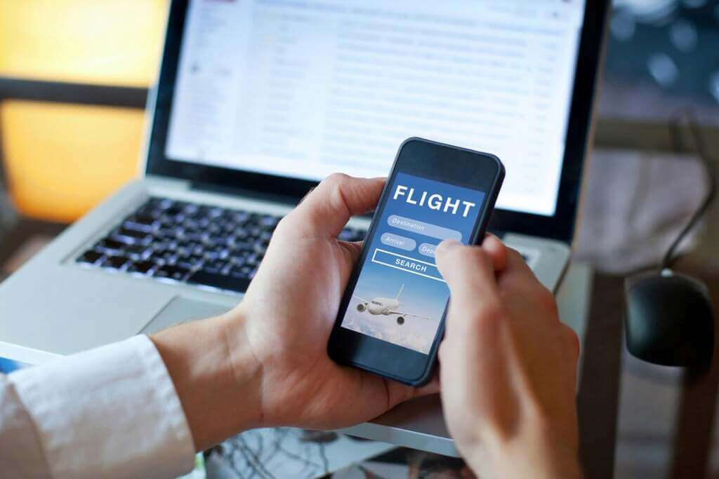
Content :
Introduction
Objective
Software & Hardware Requirement
What is C++?
Flow chart
Source Code
Output
Conclusion

Slide 3
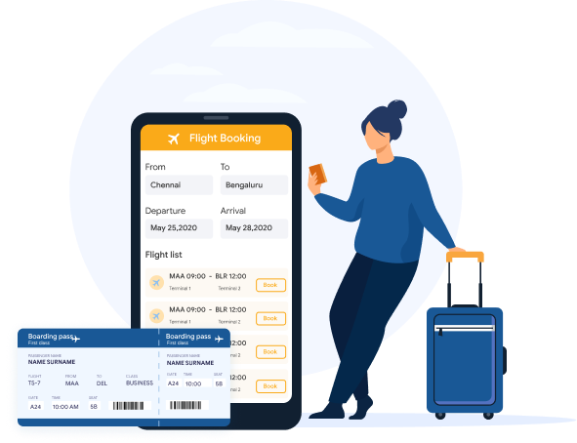
Introduction
Online air ticketing is a kind of user assistance where passenger can reserve tickets for flight in online. This is an easy method which saves a lot of time. This project entitled design and implement of an flight ticket system can be applicable to any airlines. The feature of this system will be similar as a common ticketing system and other ways it is called as
As a user:
You can search flight
You can book flight
You can check your ticket/PNR
You can update your information
You can view your ticket status

Slide 4

Objective
To make flight ticket system easier for passenger.
To save time and effort of potential air travellers.
To reduce the hassle of the user.
To easy booking on flight ticket.
To update your data easily and check the flight for travel the one place to another place.
To easy the cancel and searching the ticket.

Slide 5
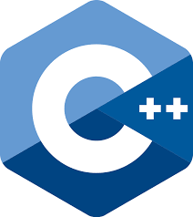
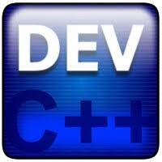
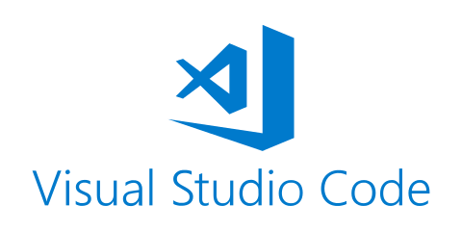

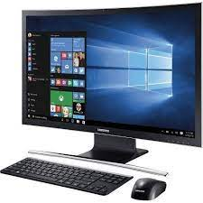

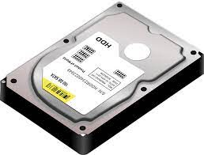

Software & Hardware Requirement
Software requirement:
Language: C++ Programming language
IDE: Visual Studio / dev C++
Compiler: Mingw-get –setup (GCC compiler)
Hardware Requirement:
Operating system – windows 7,10,11
SSD/HDD : 512 GB & minimum requirement
Ram: 8 Gb & minimum requirement
processor: Intel Core i5 & minimum requirement (Other brands)

Slide 6
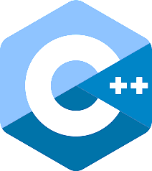
What is C++?
C++ is a cross-platform language that can be used to create high-performance applications.
C++ programming language was developed in 1980 by Bjarne Stroustrup at bell laboratories of AT&T (American Telephone & Telegraph), located in U.S.A.C++ gives programmers a high level of control over system resources and memory.
It was develop for adding a feature of OOP (Object Oriented Programming) in C without significantly changing the C component.
C++ programming is "relative" (called a superset) of C, it means any valid C program is also a valid C++ program.
The language was updated 4 major times in 2011, 2014, 2017, and 2020 to C++11, C++14, C++17, C++20.

Slide 7
Flow chart :
Start
Search Flight
Book Flight
Name, Age, Gender, Address, Aadhar & Pan No. ,
Mobile Num, Date, calss
PNR generator
If
PNR=TemPNR
?
Search Flight Ticket
Enter PNR No.
Fail
Display
If
PNR=TemPNR
?
Ticket Cancel
Enter PNR
Fail
Cancel
Exit

Slide 8
Source Code
Classes use in source code :
class Flight : Declare all variables and search option.
class Booking: Generate PNR & Booking operation.
class print_ticket : Ticket finding and print details.
class Ticket_update: Ticket Cancel & update .
class Main : Defining all function .
Function use in source code :
void new()
Void tab()
Void sTAtion();
Void search();
Void pnr_generate();
Void book();
Void search_pnr();
Void ticket_cancle();

Slide 9
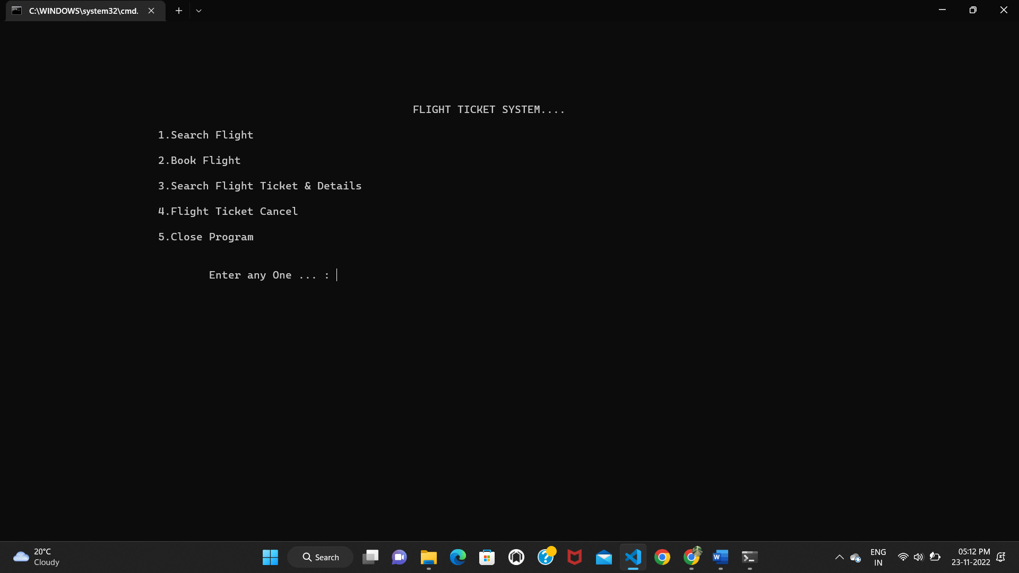
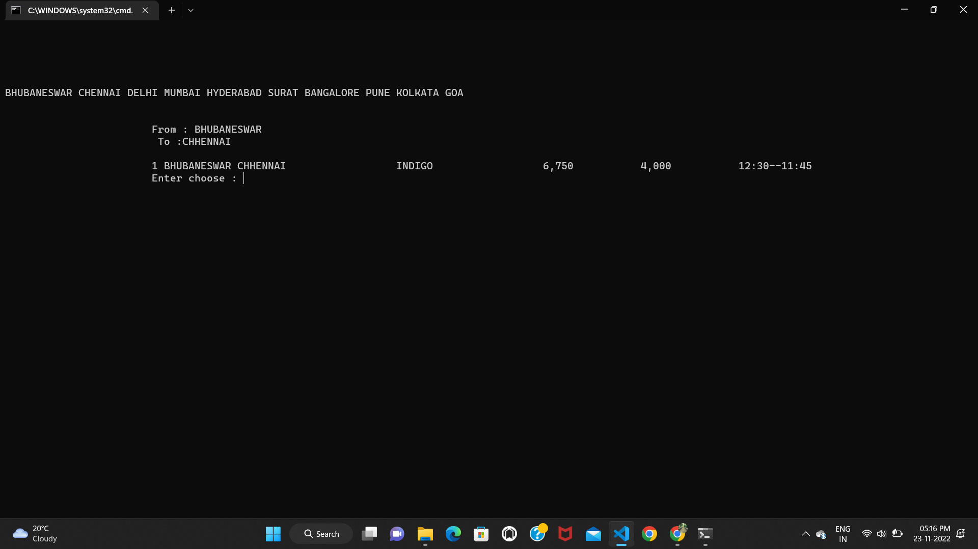
Output :

Slide 10
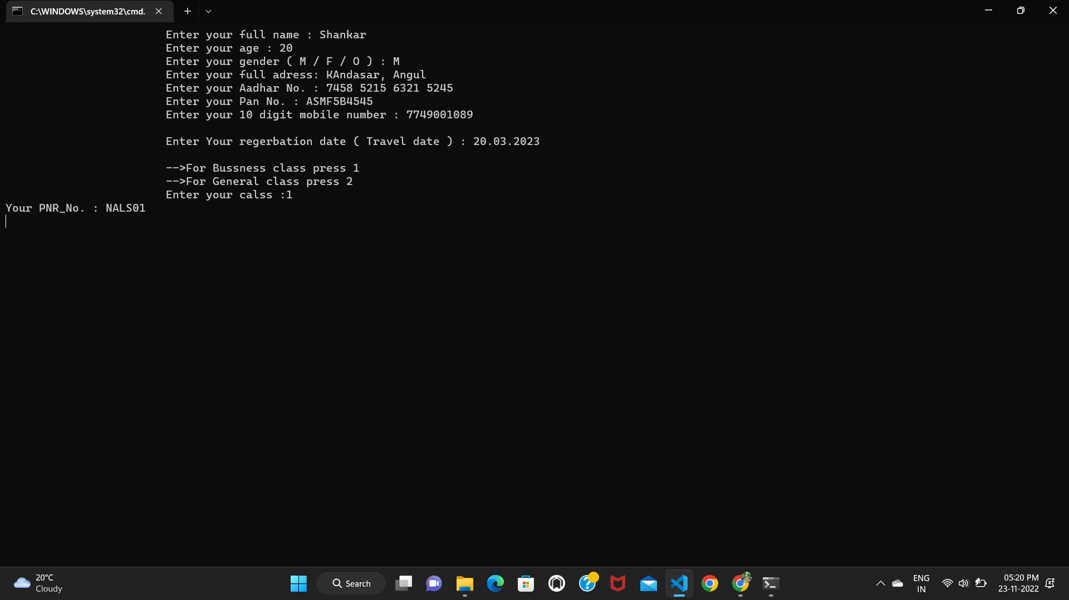
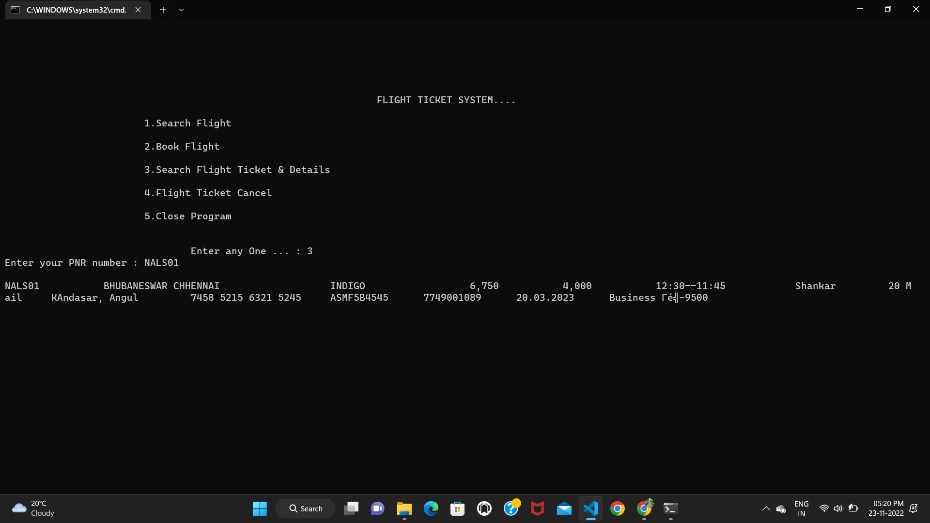

Slide 11
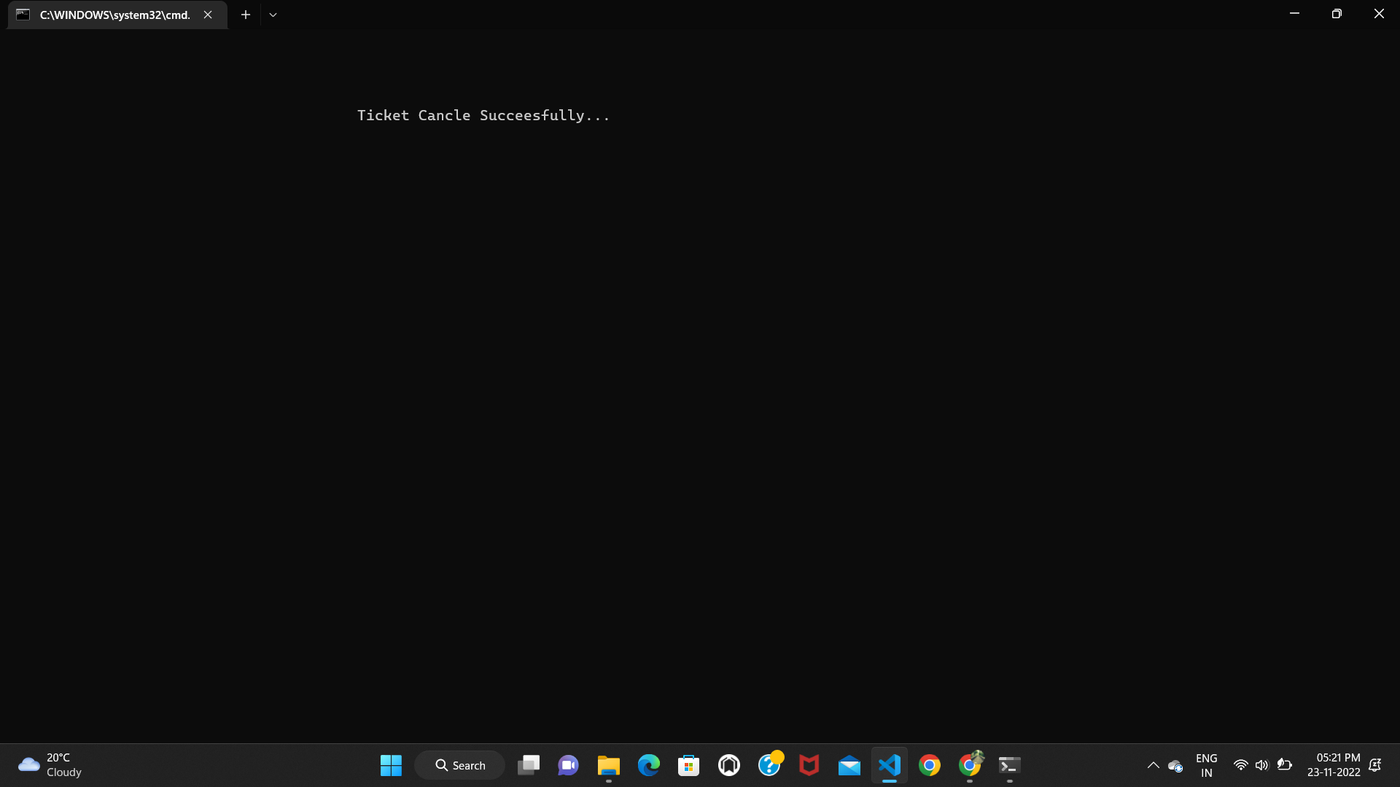
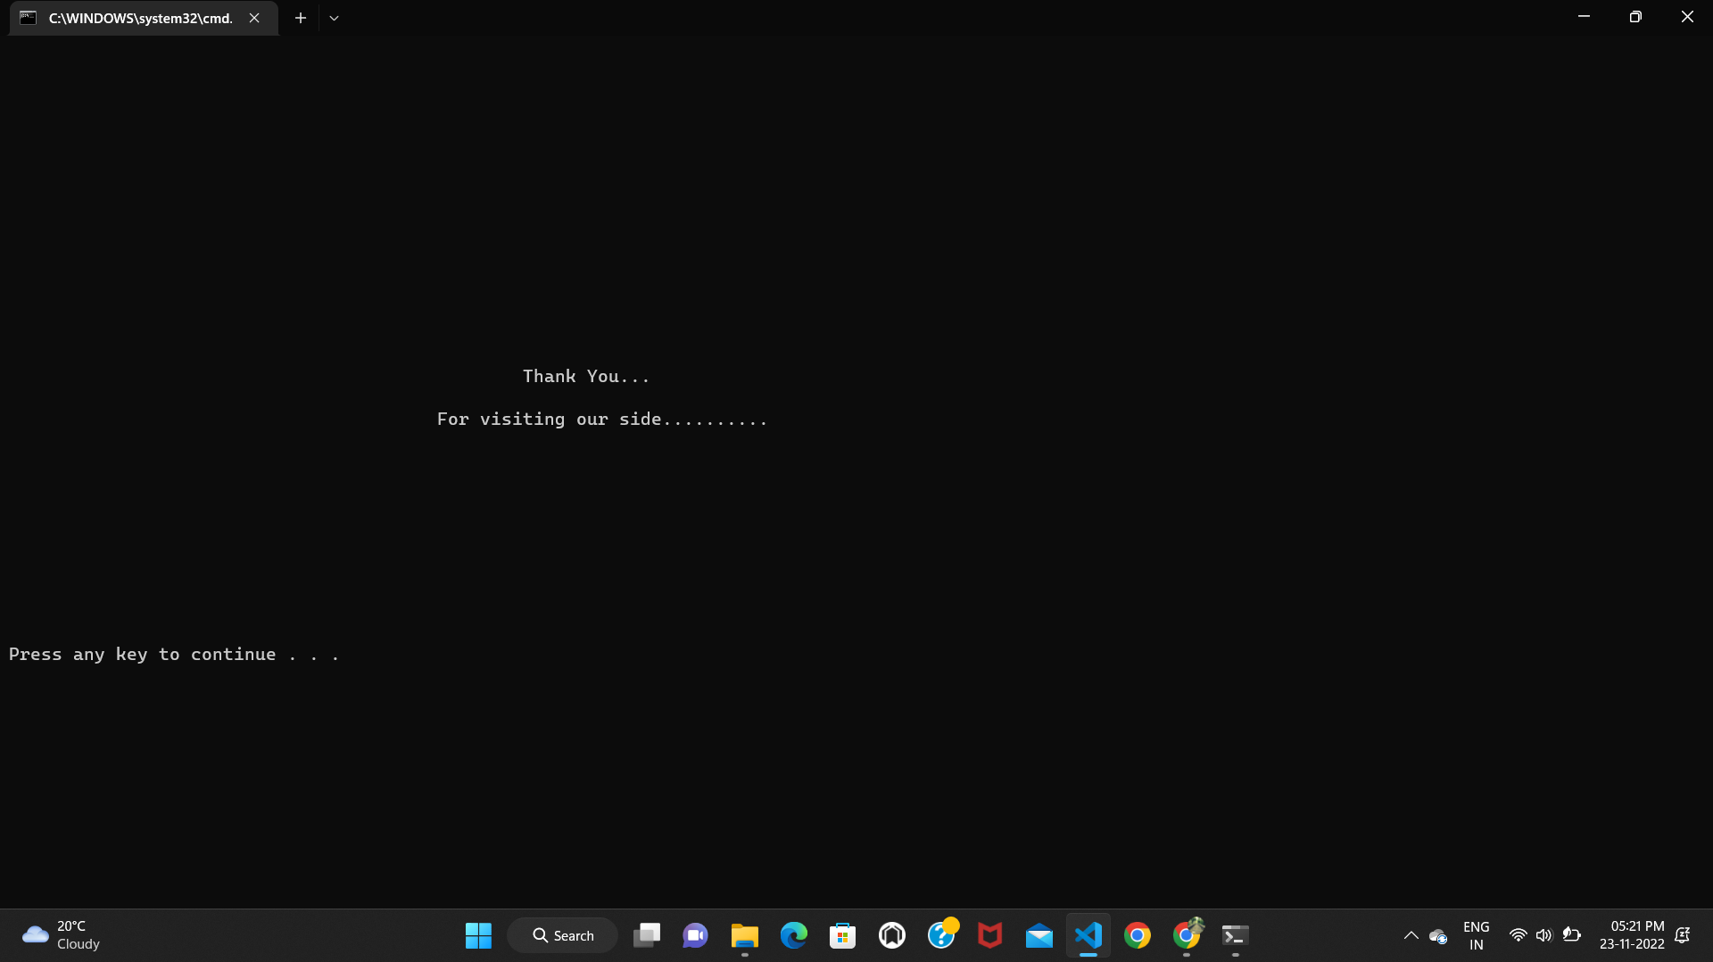

Slide 12
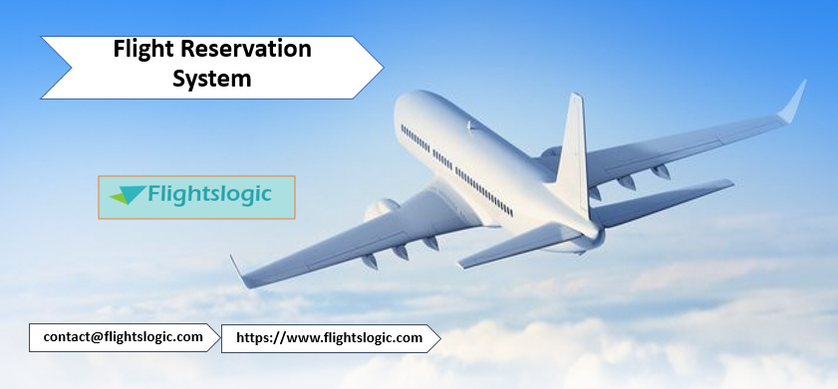
Conclusion :
The FLIGHT TICKET SYSTEM has been a way of minimizing the clerical work, which is almost a routine and consumes the most precious time. This AIRLINE FLIGHT TICKET SYSTEM has been an attempt to help the user to minimize his workload along with minimizing the paper works and saving of time .
The system has been developed in a way to make it very user friendly. It provides an on-line message and an error detection and error messages every time the user needs. Any person having a little bit of window based can run this system without any pain.
As a FUTURE ENHANCEMENT we have decided to further enhance with a seat reservation available. It is to fulfil passengers request to sit where they prefer. They are allowed to choose their seat whether near to window’s seat or in the middle.

Slide 13
Thank you!

